Slide 1
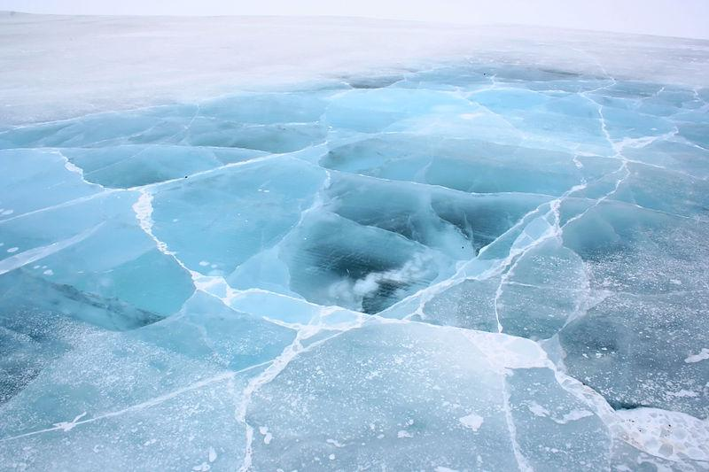
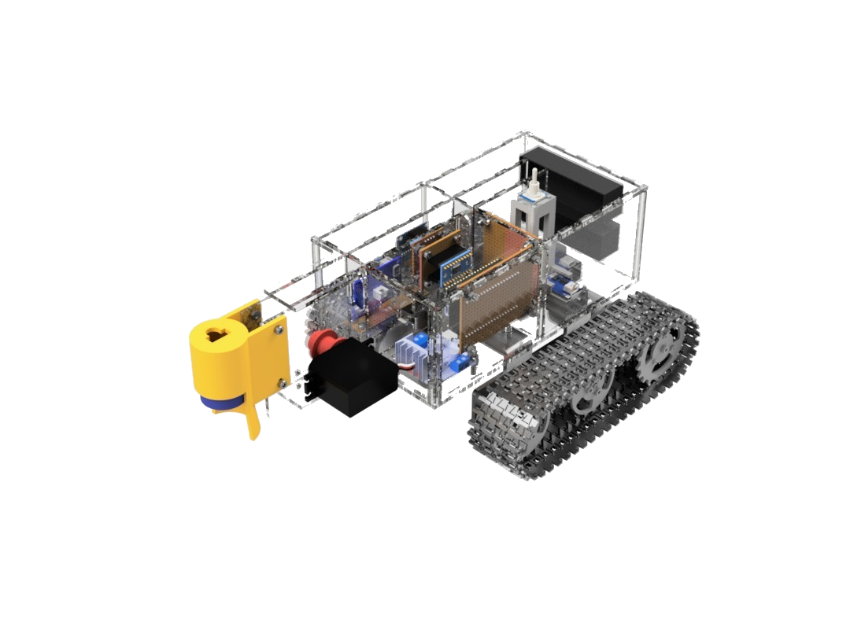
JAWS
Done by
Jayvien
Allen
Wen Da
Sean

Slide 2
Case study

Slide 3
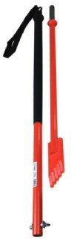
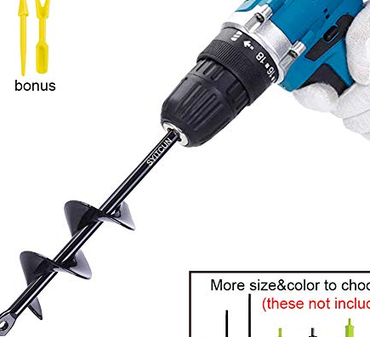
Current Methods
Cut holes in ice with wood-auger drill bits or ice chisel
Cut 12x12 inch ice block using chainsaw
Hit ice with hatchet, if there is no presence of water, it is safe to walk on

Slide 4
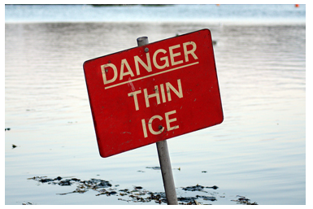
Statistics
Statistics show that more than 20 people have drowned after falling through thin ice.
More than 50 percent are due to failed attempts to rescue.

Slide 5

RISK
Australian Government states that the average annual temperature is about −10°C on the Antarctica coast to −60°C at the highest parts.
Sudden falling into the freezing water will cause a “cold water shock” which causes Sudden Death.
Cold-water shock likely causes more deaths than hypothermia.

Slide 6
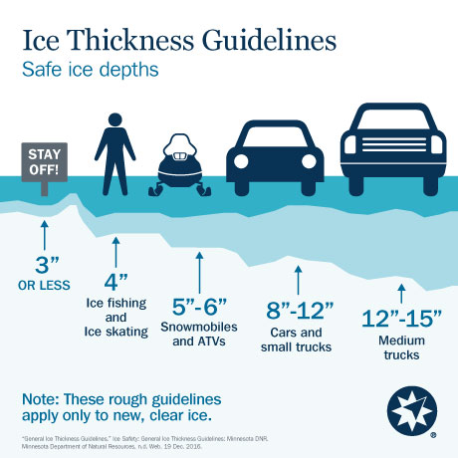
Main Purpose of our Design
Effectively prevent accidents
Collects accurate data
Ensure safety of pedestrians
Maps high risk areas

Slide 7
Code

Slide 8
Coding Areas
HTML to control movement & display the depth of the different Mediums (Air, Wood, Ice)
OLED displays: Battery life, Sensor value & status
Ultrasonic Transducer (UT) to measure the depth of the ice
Servo motor raises or lowers UT

Slide 9
Movement Control
from machine import Pin, PWM
import time
import esp32
Motor1a = Pin(0, Pin.OUT)
Motor1b = Pin(16, Pin.OUT)
Motor2a = Pin(5, Pin.OUT)
Motor2b = Pin(19, Pin.OUT)
eA = Pin(21, Pin.OUT)
eB = Pin(15, Pin.OUT)
def Forward():
Motor1a.value(1)
Motor1b.value(0)
Motor2a.value(1)
Motor2b.value(0)
eA.value(1)
eB.value(1)
def Backward():
Motor1a.value(0)
Motor1b.value(1)
Motor2a.value(0)
Motor2b.value(1)
eA.value(1)
eB.value(1)
def Left():
Motor1a.value(0)
Motor1b.value(0)
Motor2a.value(1)
Motor2b.value(0)
eA.value(1)
eB.value(1)

Slide 10
def Right():
Motor1a.value(1)
Motor1b.value(0)
Motor2a.value(0)
Motor2b.value(0)
eA.value(1)
eB.value(1)
def Stop():
Motor1a.value(0)
Motor1b.value(0)
Motor2a.value(0)
Motor2b.value(0)
eA.value(1)
eB.value(1)
def rest():
stop()
time.sleep(1)

Slide 11
while True:
control = input()
if control == 'w':
Forward()
time.sleep(1)
#Enter w in shell to move forward
elif control == 's':
Backward()
time.sleep(1)
#Enter s in shell to move backward
elif control == 'a':
Left()
time.sleep(1)
#Enter a in shell to move left
elif control == 'd':
Right()
time.sleep(1)
#Enter d in shell to move right
elif control == 'q':
Stop()
time.sleep(1)
#Enter q in shell to stop
else:
control.clear() #Other letters won’t work

Slide 12
OLED code (Switch screen)
from machine import Pin, I2C
import ssd1306
from time import sleep
import time
i2c = I2C(-1, scl=Pin(22), sda=Pin(21)) #3.3V -Red & Gnd -Black ,#Clock Line & Data Line
oled_width = 128
oled_height = 64
oled = ssd1306.SSD1306_I2C(oled_width, oled_height, i2c)
oled.text('SAFElol', 0, 0)
time.sleep(3)
oled.show()
oled.fill(0)
oled.text('welp', 0, 0)
time.sleep(3)
oled.show()

Slide 13
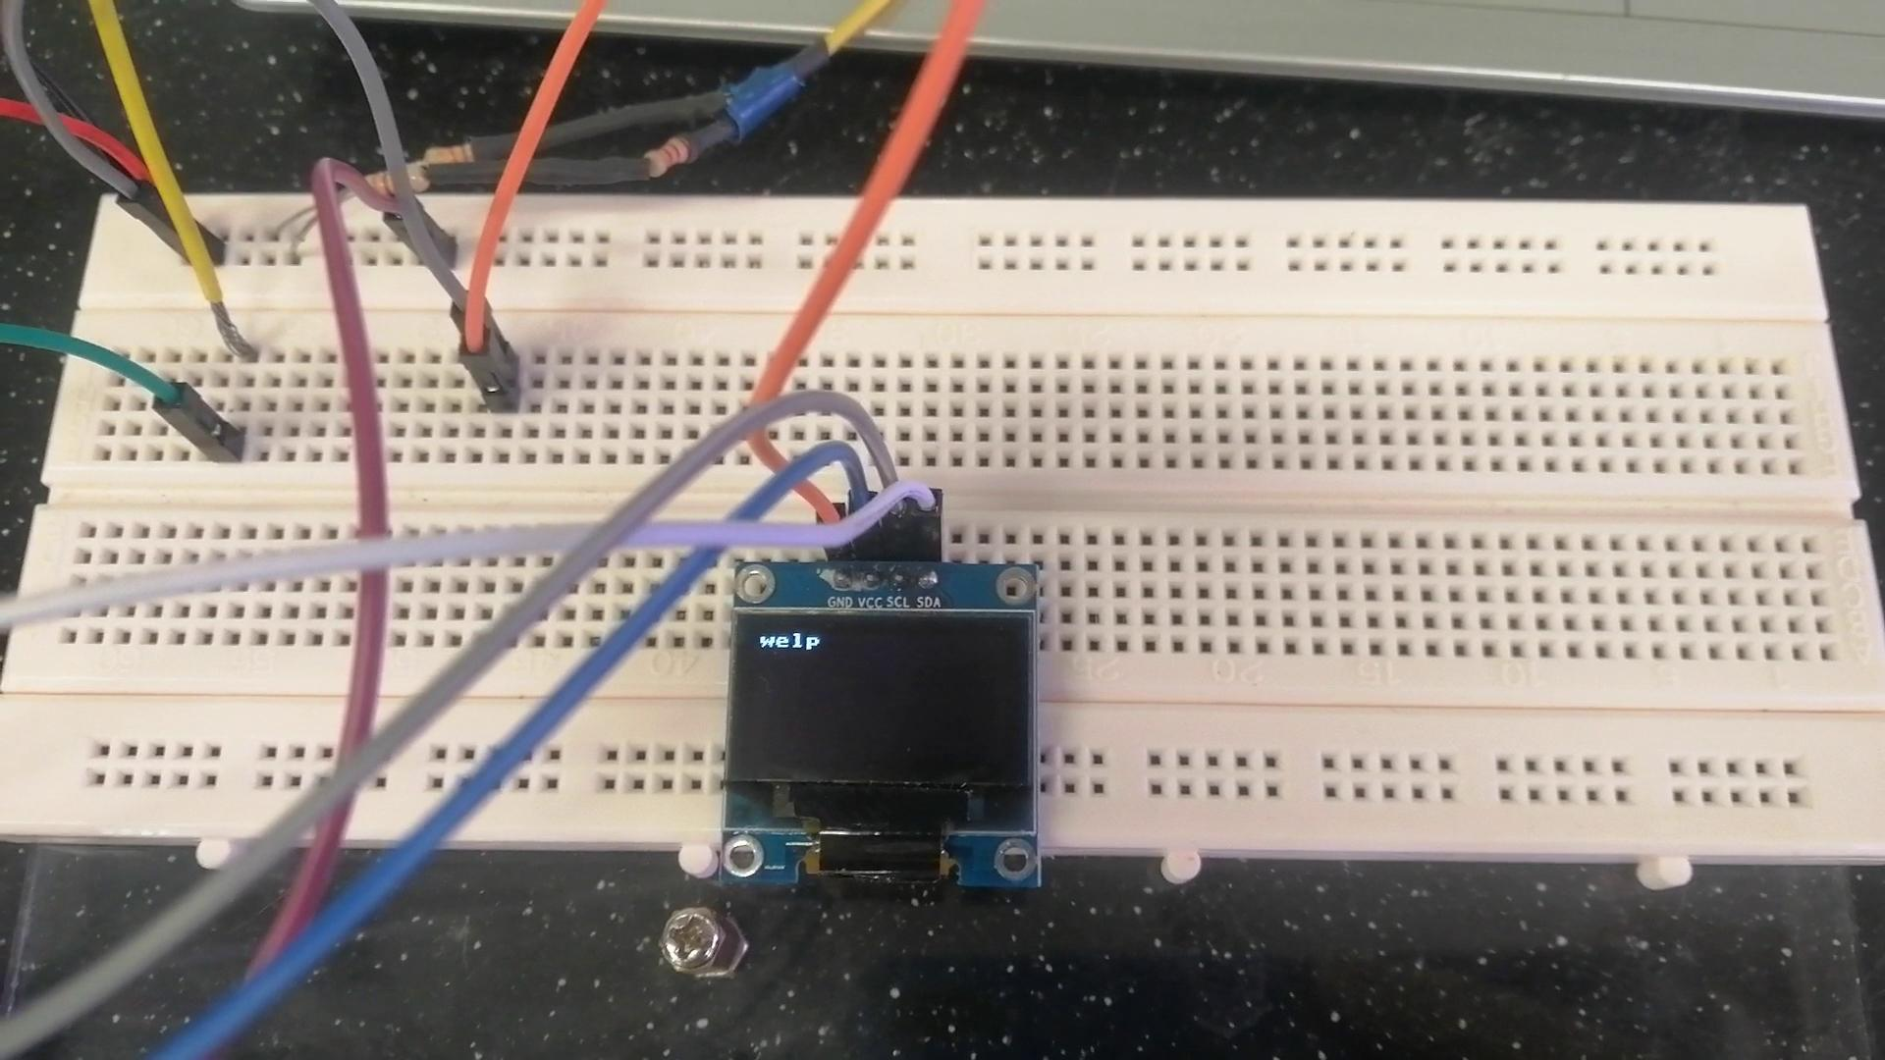

Slide 14
OLED (Battery indicator)
from machine import Pin, I2C, ADC
import ssd1306
from time import sleep
import machine
import sys
import time
#voltage divider code
pot = ADC(Pin(33))
pot.atten(ADC.ATTN_11DB)
value=0
def show():
while True:
value = pot.read()
CVolt= (value/4095)*3.3*4
print(CVolt)
time.sleep(1)
return CVolt
CVolt = show()
#OLED MAIN CODE
i2c = I2C(-1, scl=Pin(22), sda=Pin(21))
oled_width = 128
oled_height = 64
oled = ssd1306.SSD1306_I2C(oled_width, oled_height, i2c)
while (1):
CVolt = round(show())
oled.text('SAFElol', 0, 0)
time.sleep(3)
oled.show()
oled.fill(0)
oled.text(str(CVolt), 0, 0)
time.sleep(3)
oled.show()

Slide 15
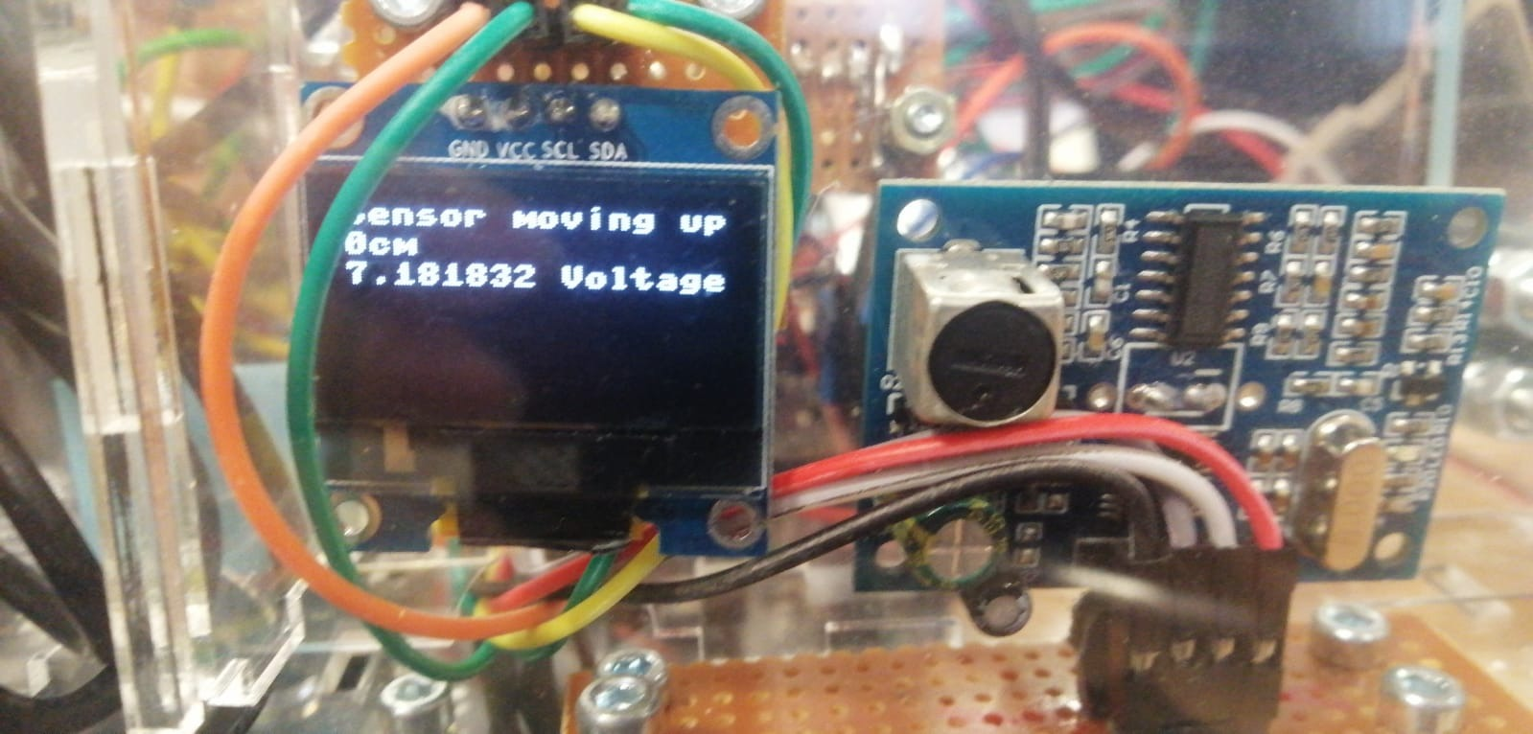
OLED DISPLAY (IN HTML)
def display():
oled.fill(0)
CVolt = batt()
oled.text( jaws_state, 0 , 0)
oled.text( str(cm) + ' cm', 0, 10)
oled.text( str(CVolt) + ' Voltage', 0, 20)
oled.show()

Slide 16

Main function of vehicle
Maneuver on ice with no slippage/little difficulty remotely (about 5 meters away)
Accurately detect the depth of ice/desired medium ( + 1cm)

Slide 17
Effectiveness of main function
Vehicle able to move on Ice
Servo able to lower sensor
Ultrasonic transducer accuracy
OLED Display
HTML Control
Charging Battery function

Slide 18
Esp32 as WEB SERVER
Must be 8 Characters
ssid = 'WenDaESP'
password = 'meowmeowmeow'
authmode = 3 #3=requires password, 0=oppen
ap = network.WLAN(network.AP_IF)
ap.active(True)
ap.config(essid=ssid, password=password, authmode=authmode)
ap.ifconfig(('192.168.16.4', '255.255.255.0', '192.168.16.1', '8.8.8.8'))
while ap.active() == False:
pass
print('Connection successful')
print(ap.ifconfig())
try:
import usocket as socket
except:
import socket
import network
import esp
esp.osdebug(None)
import gc
gc.collect()
Set IpAdress

Slide 19
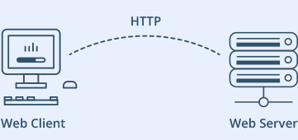
Esp32 as server
While True:
conn, addr = s.accept()
print('Got a connection from %s' % str(addr))
request = conn.recv(1024)
request = str(request) #determine after the ip address
print('Content = %s' % request)
s = socket.socket(socket.AF_INET, socket.SOCK_STREAM)
s.bind(('', 80))
s.listen(5)

Slide 20
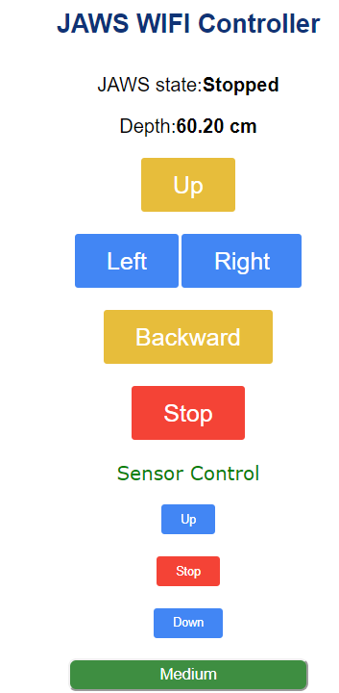
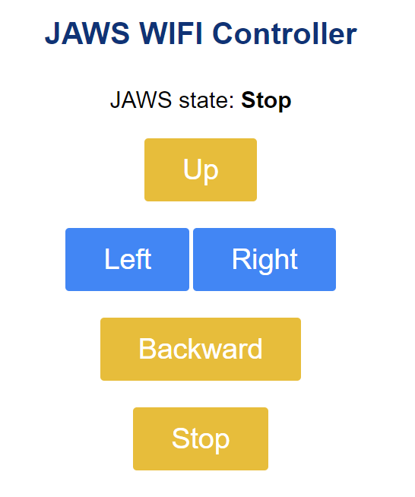
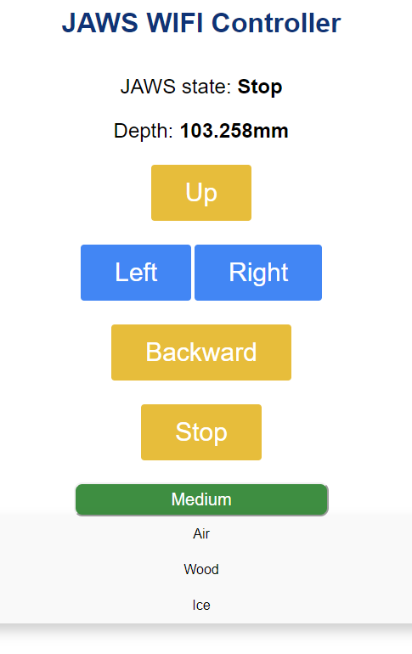
Development of Html buttons

Slide 21
Html buttons
<h1>JAWS WIFI Controller</h1><p>JAWS state:<strong>
""" + jaws_state + """
</strong></p>
<p>Depth:<strong>
""" + str(cm) + """cm
</strong></p>
<p><a href="/?Forward=true"><button class="button">Up</button></a></p>
<p><a href="/?Left=true"><button class="button button2">Left</button></a><a href="/?Right=true"><button class="button button2">Right</button></a></p>
<p><a href="/?Backward=true"><button class="button button4">Backward</button></a></p>
<p><a href="/?Stop=true"><button class="button button5">Stop</button></a></p>
<p>
<font face="verdana" color="green">Sensor Control</p></font>
<p><a href="/?Servo=up"><button class="button button6">Up</button></a></p>
<p><a href="/?Servo=Stop"><button class="button button7">Stop</button></a></p>
<p><a href="/?Servo=down"><button class="button button8">Down</button></a></p>

Slide 22
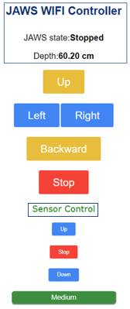
Html control
while True:
conn, addr = s.accept()
print('Got a connection from %s' % str(addr))
request = conn.recv(1024)
request = str(request)
#determine after the ip address, what motion is JAWS in
print('Content = %s' % request)
forward = request.find('/?Forward=true')
backward = request.find('/?Backward=true')
left = request.find('/?Left=true')
right = request.find('/?Right=true')
backward = request.find('/?Backward=true')
stop = request.find('/?Stop=true')
#Medium
air = request.find('/?Air')
wood = request.find('/?Wood')
ice = request.find('/?Ice')
#Servo motor control ((Move sensor)
servoup = request.find('/?Servo=up')
servostop = request.find('/?Servo=stop')
servodown = request.find('/?Servo=down')

Slide 23
movement
if forward == 6:
print('FORWARD')
Forward()
jaws_state = "Forward"
if backward == 6:
print('BACKWARD')
Backward()
jaws_state = "Backward"
if right == 6:
print('RIGHT')
Right()
jaws_state = "Right"
if left == 6:
print('LEFT')
Left()
jaws_state = "Left"
if stop == 6:
print('STOPPED')
Stop()
jaws_state = "Stopped"
else:
Stop()

Slide 24
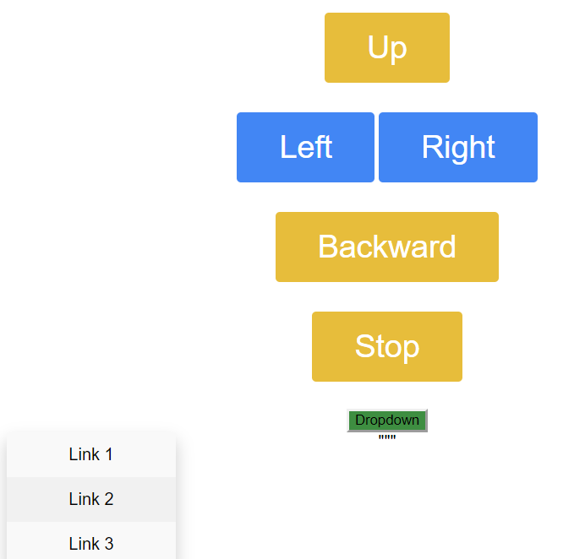
Html dropdown position
.dropdown-content {
display: none;
position: relative;
background-color: #f9f9f9;
min-width: 160px;
box-shadow: 0px 8px 16px 0px rgba(0,0,0,0.2);
z-index: 1;
}
.dropdown:hover .dropbtn {
background-color: #3e8e41;
width: 300px;
height: 40px;
font-size: 20px;
border-radius: 10px;
color: white;
}
.dropbtn {
background-color: #3e8e41;
width: 300px;
height: 40px;
font-size: 20px;
border-radius: 10px;
color: white;
}
Instead of absolute

Slide 25
Servo control
if servoup == 6:
print('Sensor Up')
Stop()
jaws_state = "Sensor moving up"
servoup()
if servostop == 6:
print('Sensor Stop')
Stop()
jaws_state = "Sensor stop moving"
servostop()
if servodown == 6:
print('Sensor moving down')
Stop()
jaws_state = "Sensor moving down"
servodown()

Slide 26
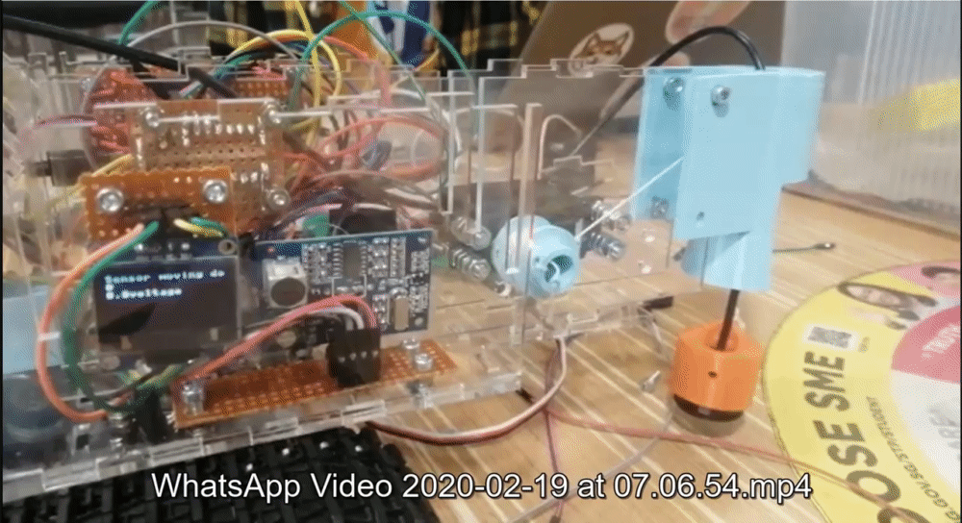
Servo control
def servoup():
servo = machine.PWM(machine.Pin(19), freq=1000)
servo.duty(1000)
time.sleep_ms(500) #ensure that the sensor doesnt keep moving
servostop()
def servodown():
servo = machine.PWM(machine.Pin(19), freq=500)
servo.duty(200)
time.sleep_ms(500) #ensure that the sensor doesnt keep moving
servostop()

Slide 27
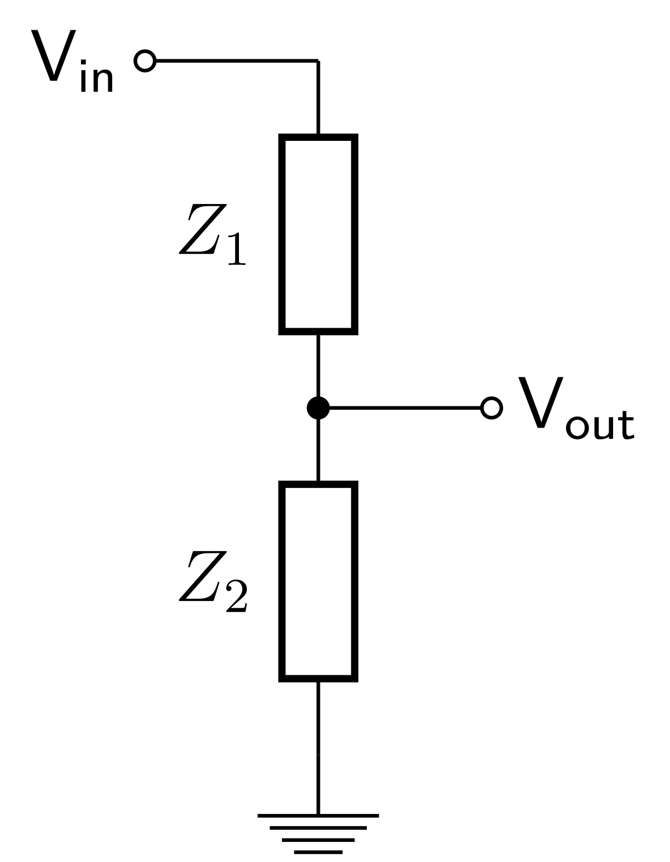
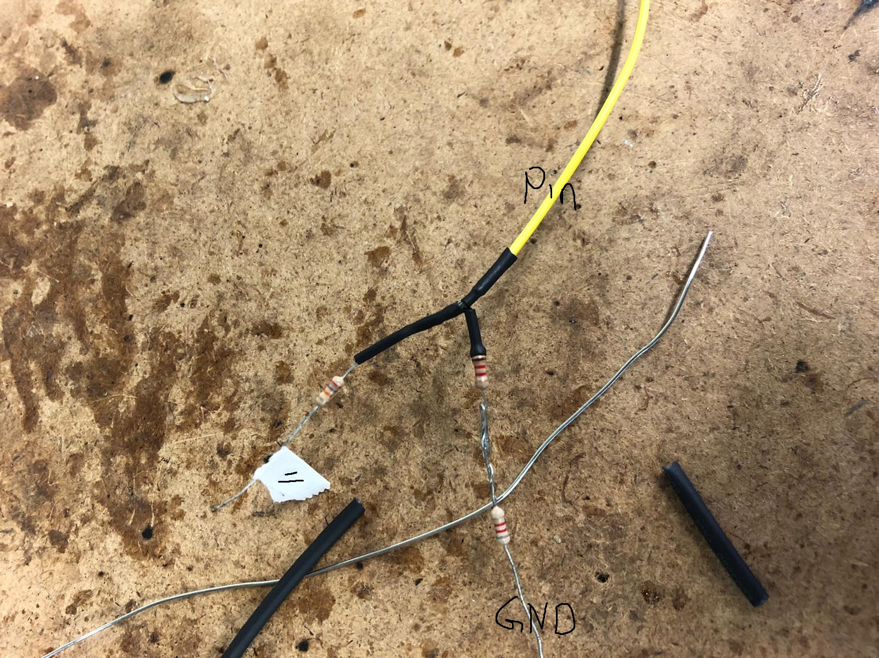
Voltage divider
from machine import Pin , ADC
pot = ADC(Pin(32)) #Voltage Divider pin
pot.atten(ADC.ATTN_11DB) #Initial Read
voltread = 0
def batt():
voltread = pot.read()
CVolt= (voltread/4095)*3.3*4
print(CVolt)
return CVolt
Z1 = 9200 ohm
Z2 = 10000 ohm

Slide 28
Transducer Medium
if air == 6:
print('Dist in Air')
Stop()
jaws_state = "Reading Distance (Medium: Air)"
depth()
cm = depth()
if wood == 6:
print('Dist in Wood')
Stop()
jaws_state = "Reading Distance (Medium: Wood)"
depthwood()
cm = depthwood()
if ice == 6:
print('Dist in Ice')
Stop()
jaws_state = "Reading Distance (Medium: Ice)"
depthice()
cm = depthice()

Slide 29
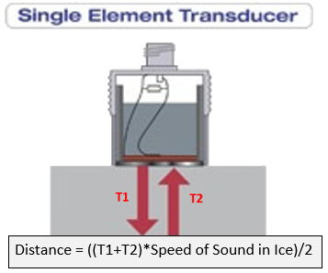
UltraSonic transducer
def depth(): #default is air
t1=0
t2=0
trig.off() #//stop reading
utime.sleep_us(2)
trig.on()
utime.sleep_us(10)
trig.off()
while echo.value() == 0:
pass
t1 = utime.ticks_us()
while echo.value() == 1:
pass
t2 = utime.ticks_us()
cm = ((t2 - t1)*(343/10000))/2;
print(cm)
utime.sleep(2)
return cm

Slide 30
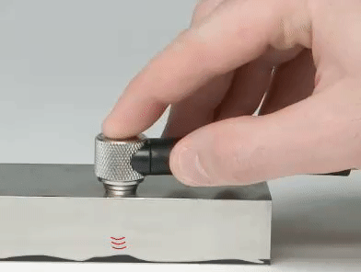
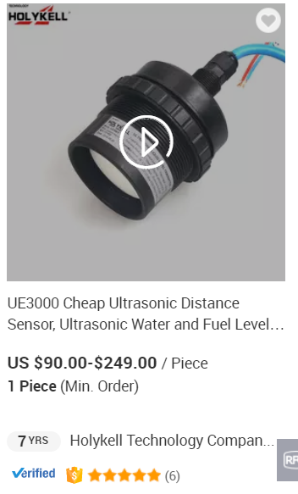
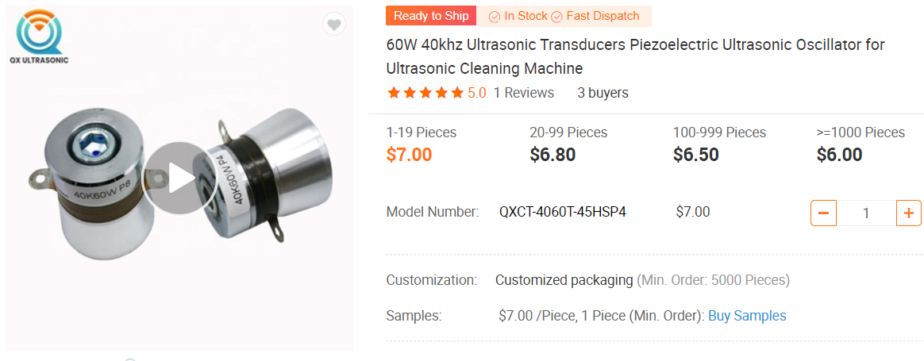
UltraSonic transducer
NDT Solutions
Dual Element Transducers

Slide 31
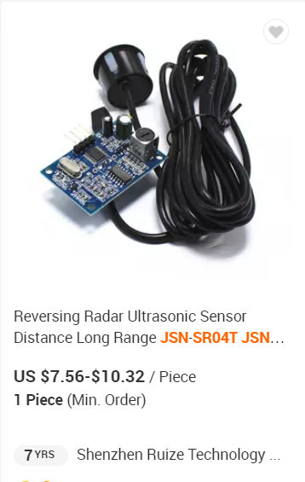
Ultrasonic Waterproof Range Finder
Small & easy to use
Low voltage & power consumption
High precision measurement
Strong anti-interference
Integrated closed waterproof cable probe, suitable for wet/moist environment

Slide 32
Ultrasonic Waterproof Range Finder
Farthest range: 600cm
Recent range: 20cm
Distance accuracy: +- 1cm
Resolution: 1mm
Measuring angle: 75°
Operating temperature: -20 ° C to + 70 ° C

Slide 33
Electrical

Slide 34
Electrical design: INtro
Compact circuit design
Segregated circuits
Neat circuits

Slide 35
Electrical Components
MT3608 boost converter → Up voltage for motor
L298N DC motor driver → Controlling motors
ESP 32 microcontroller → “brain” of the vehicle
JSN-SR04T-2.0 ultrasonic sensor → To measure the depth of ice
HW-0108 logic converter → To change the logic signals of components
SSD1306 OLED display → To display our battery life/ status on it
TP4056 charging module → Charge the batteries
SM-S4315R servo motor → Raising/lowering the receiver of sensor

Slide 36
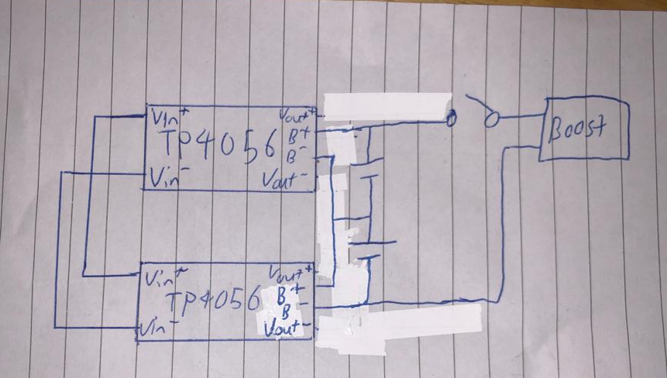
Electrical Design - First power circuit

Slide 37
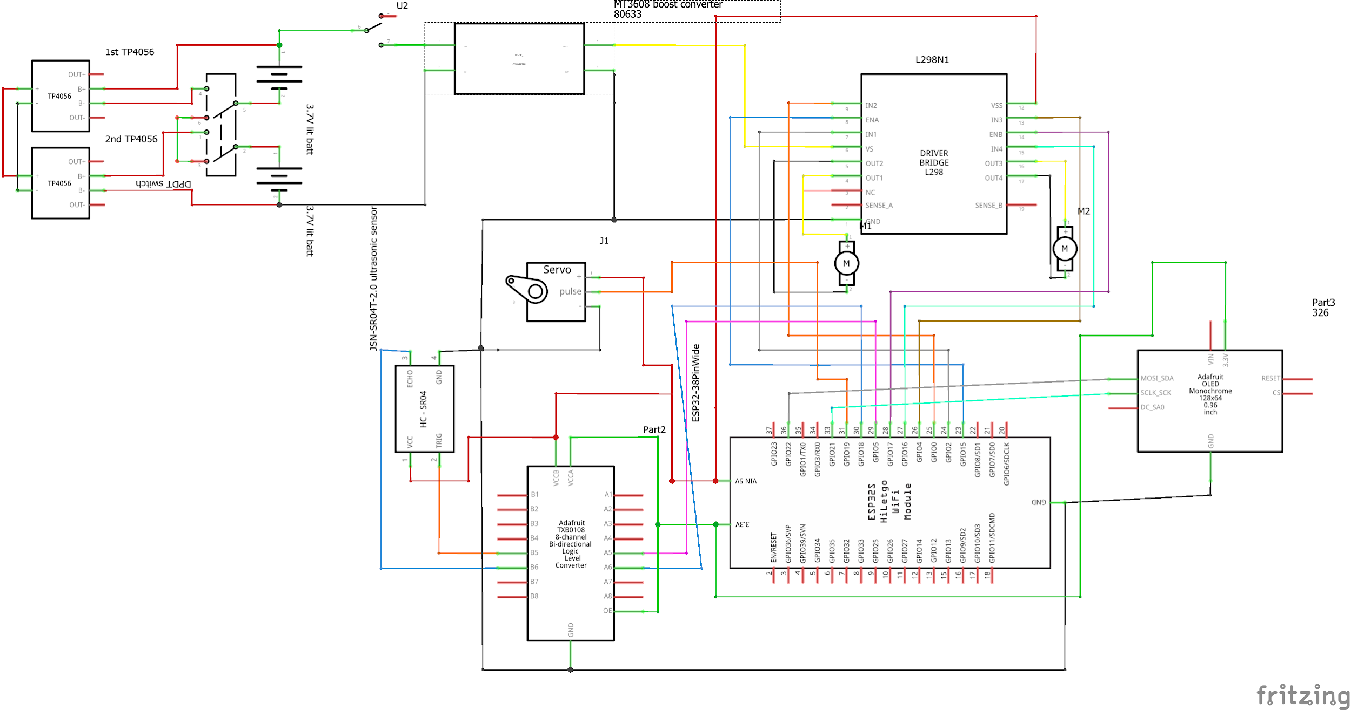
Electrical Design - Power revised

Slide 38
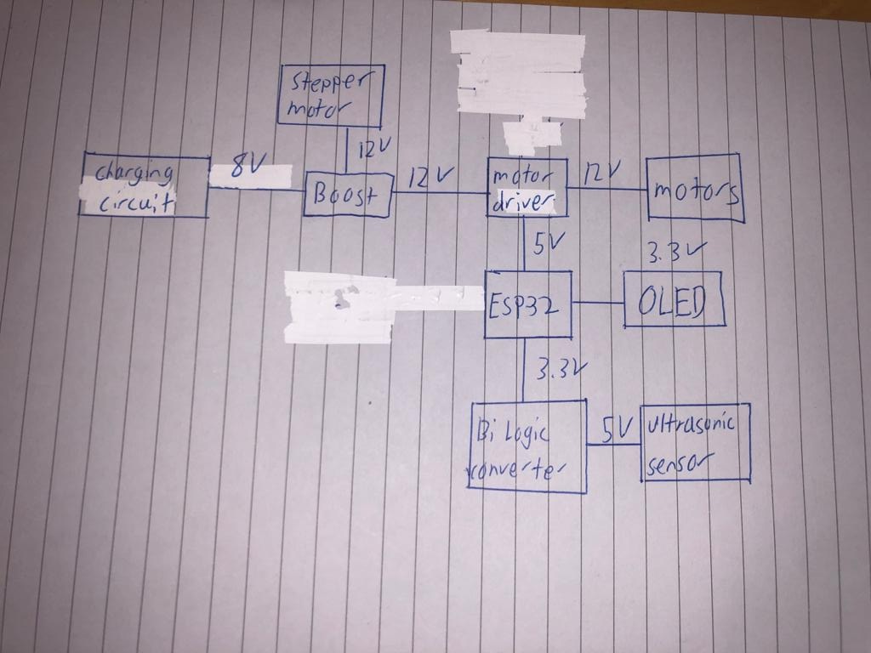
Electrical Design - First block diagram

Slide 39
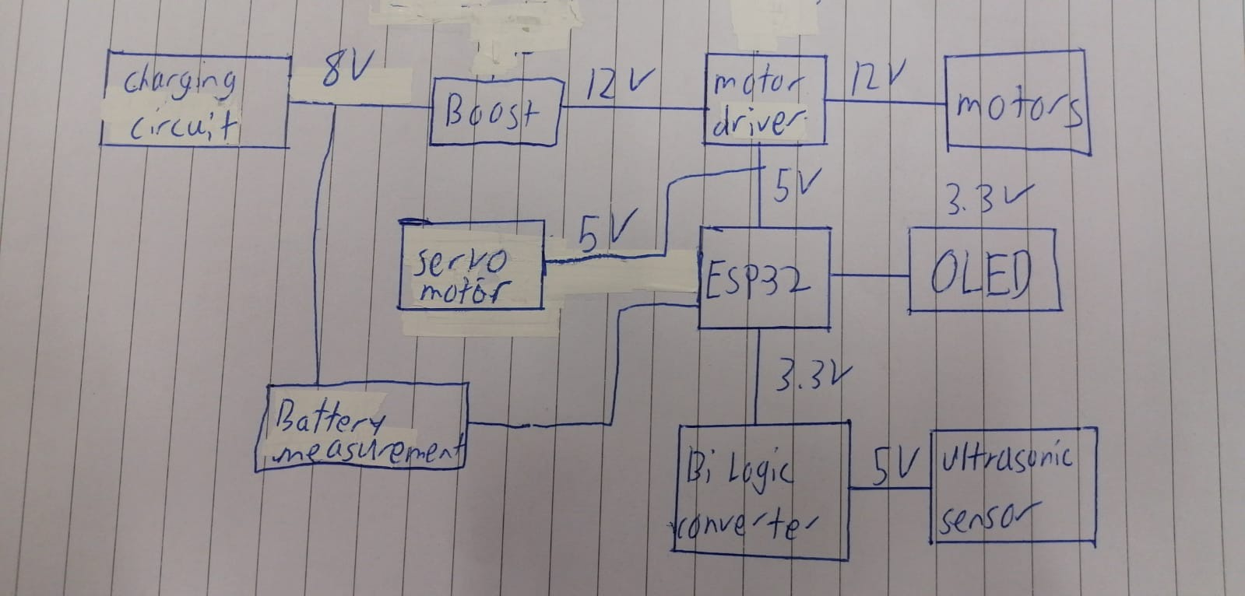
Electrical Design - Final schematic

Slide 40
Power calculations
Component | Voltage(V) | Current(mA) | Quantity | Power(W)
12V DC motor | 12 | 700 | 2 | 16.8
SM-S4315R | 5 | 800 | 1 | 4
ESP32 board | 3.3 | 60 | 1 | 0.198
SSD1306 | 3.3 | 20 | 1 | 0.1
JSN-SR04T | 5 | 5 | 1 | 0.025
Total power |  |  |  | 21.123

Slide 41
Electrical Design
Battery energy(Wh) = 7.4V x 3 mAh = 22.2Wh
Therefore, the runtime of the vehicle
= 22.2 / 21.123
= 1.05098…
= 1.05Wh(3sf)
*Assuming all parts are activated at all times.
Thus, considering either the motor or the servo is activated at a time, the average runtime is 1.5h

Slide 42
mechanical

Slide 43
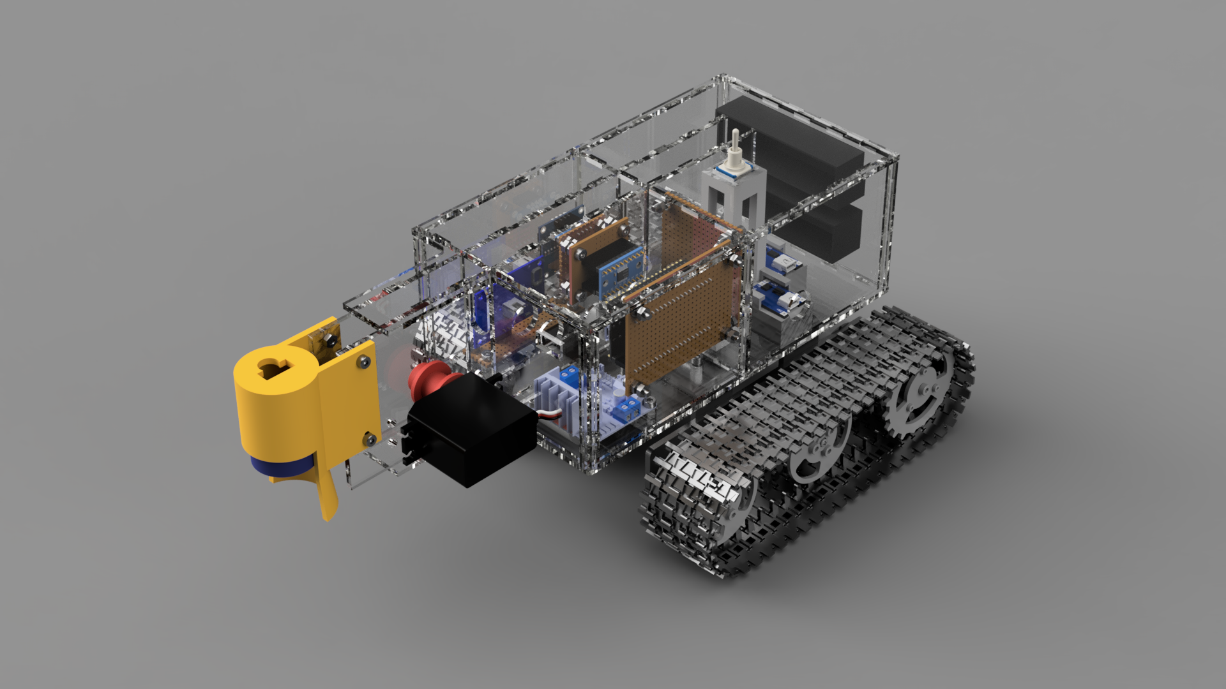
3D Model

Slide 44
Mechanical arm design
Mechanism that lowers/raises ultrasonic transducer (UT)
Surface of UT parallel & flat to the ground surface

Slide 45
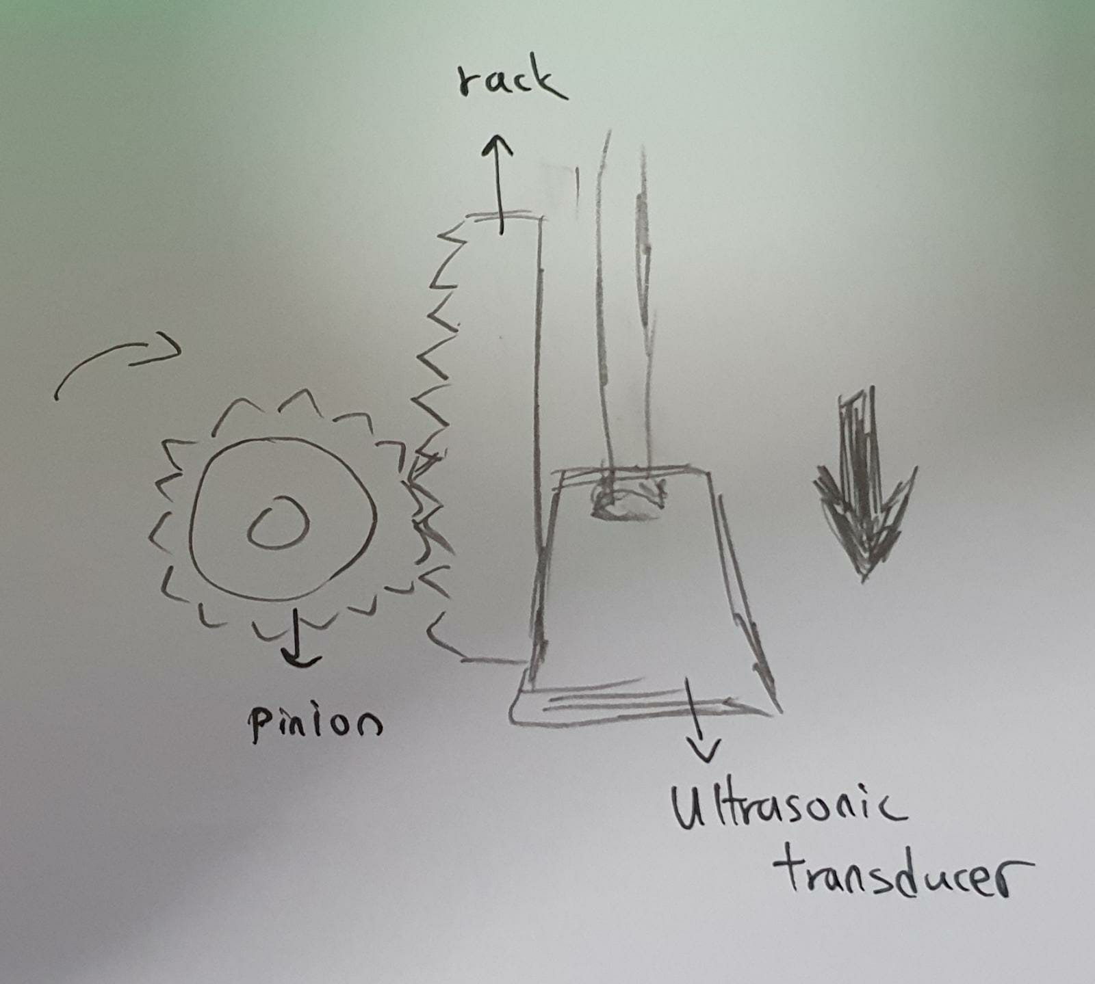
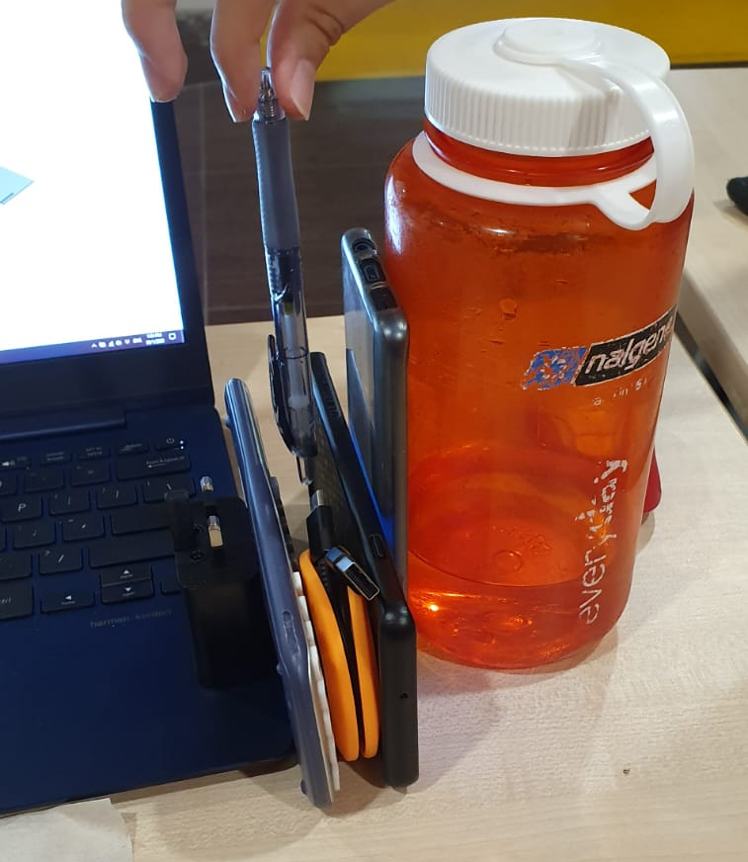
Mechanical arm design - concepts
Rack
and Pinion

Slide 46
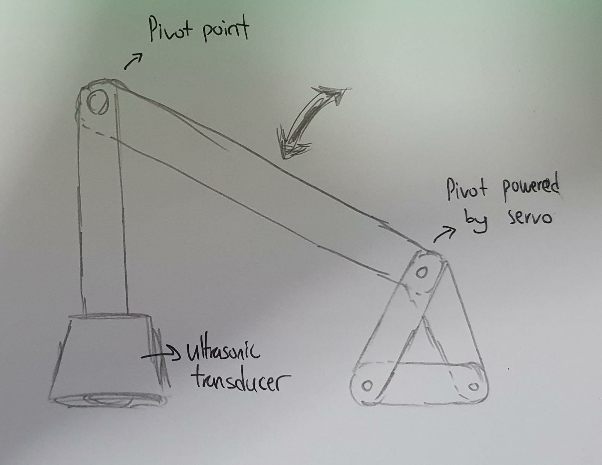
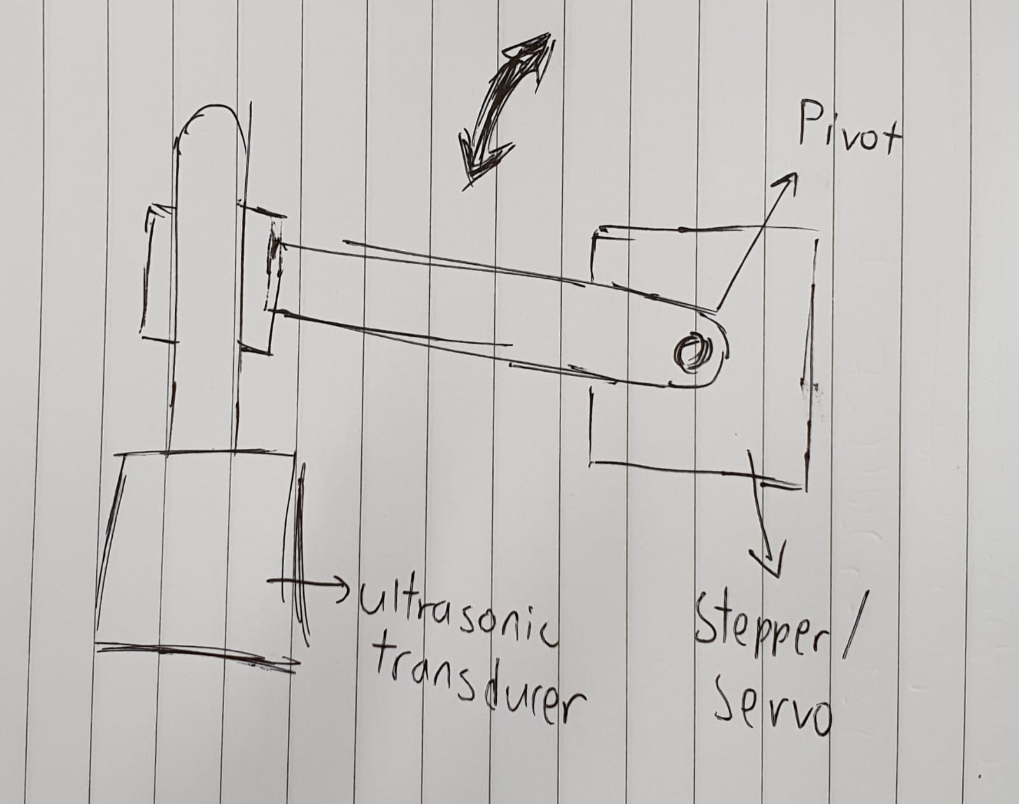
Mechanical arm design - concepts
Using Linkages

Slide 47
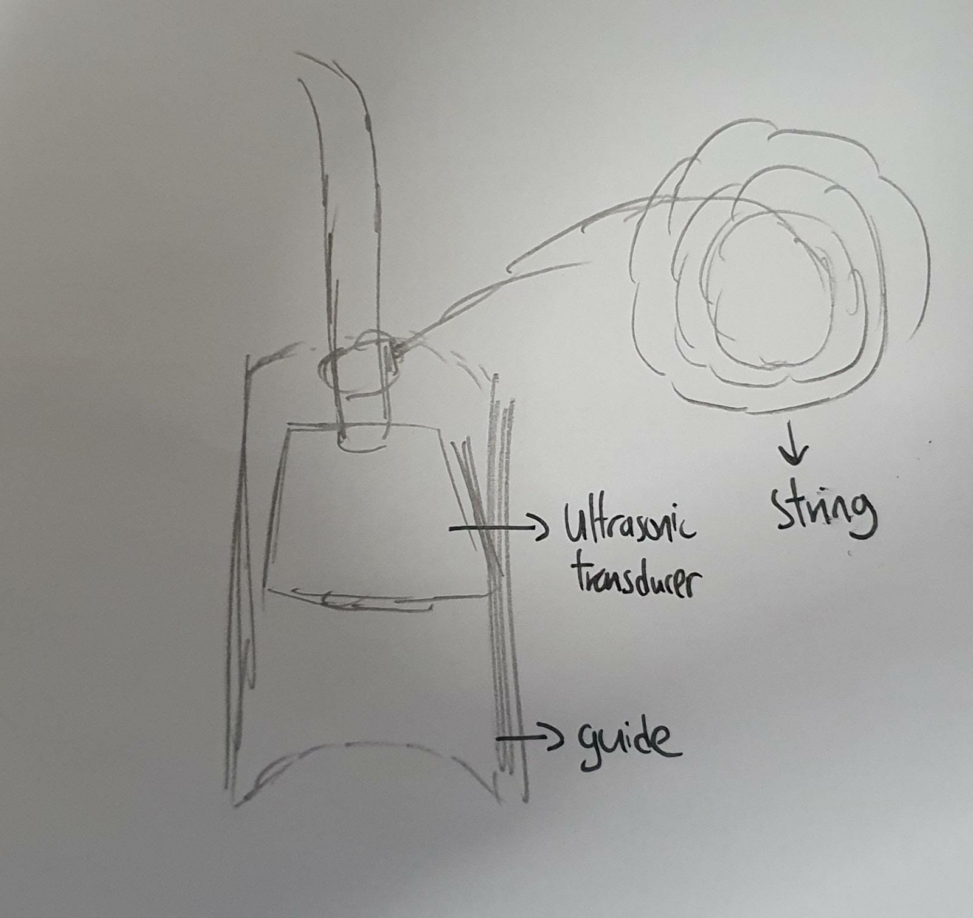
Mechanical arm design - concepts
Using String & Gravity (Chosen Design)

Slide 48
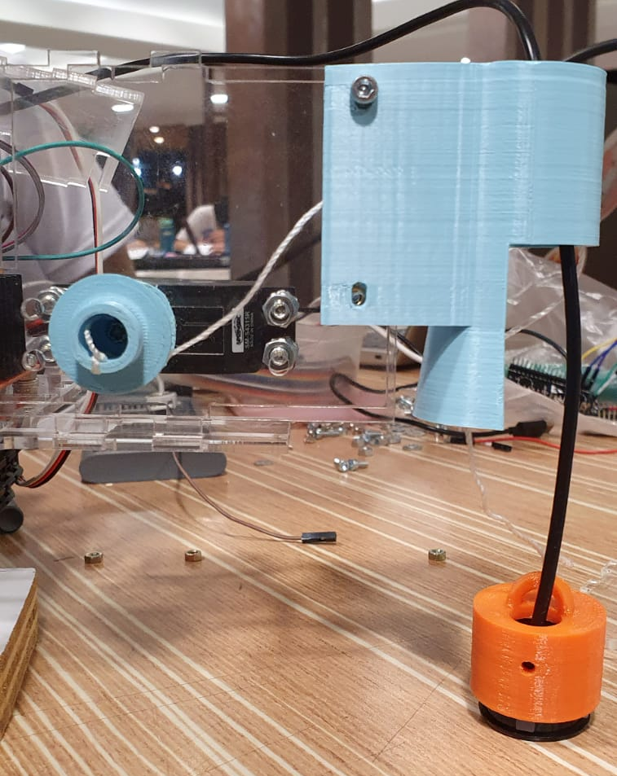
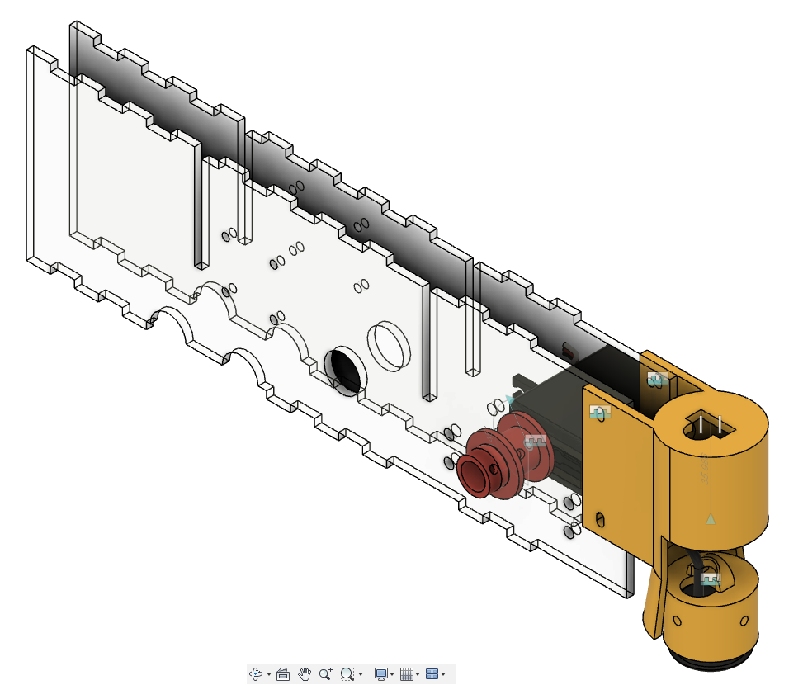
Mechanical arm design
Using a 360 servo motor
Rotate a spool
Nylon string used to lower/raise

Slide 49
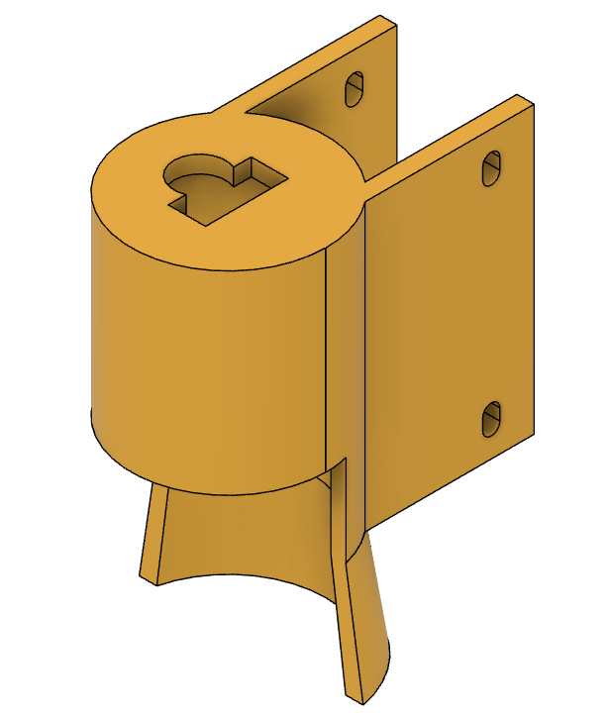
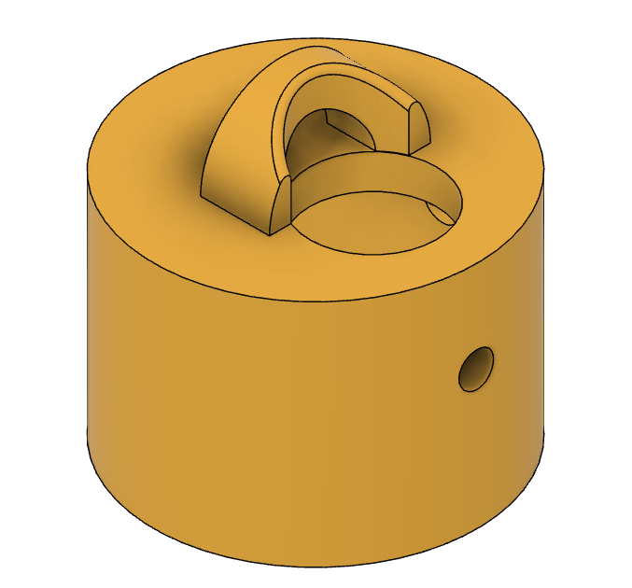
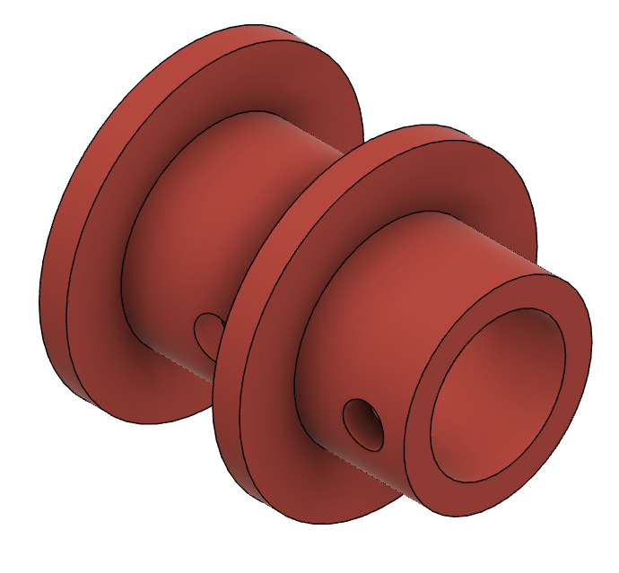
3D Printed parts - Raising/Lowering Mechanism
Spool
(for string)
Ultrasonic Transducer Guide
Ultrasonic Transducer Holder

Slide 50
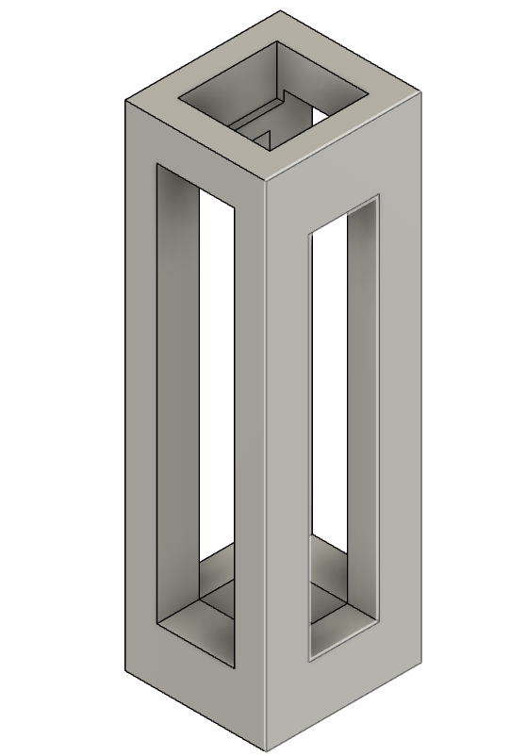
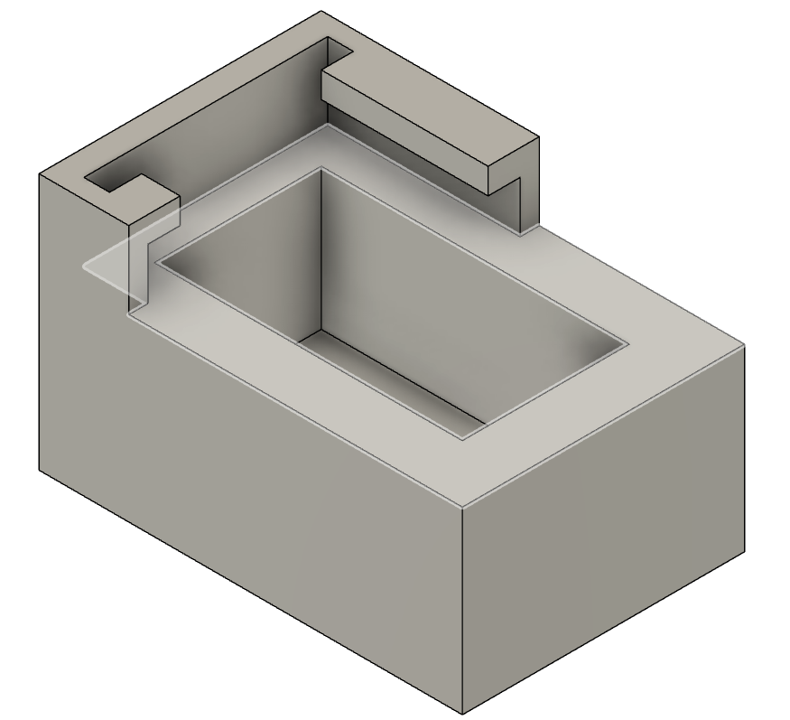
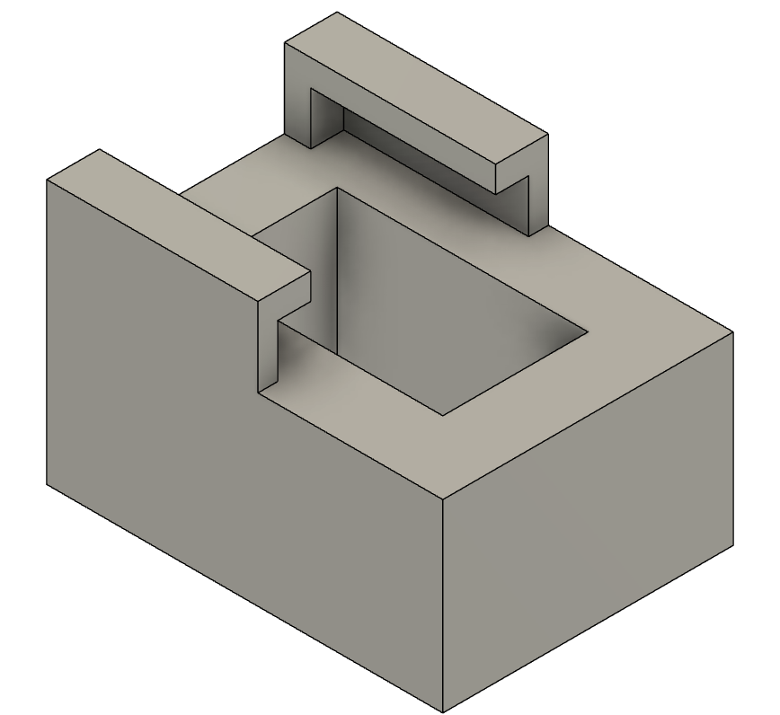
3d printed parts - Power Compartment
MT3608 Holder
TP4056 Holder
Switch Holder

Slide 51
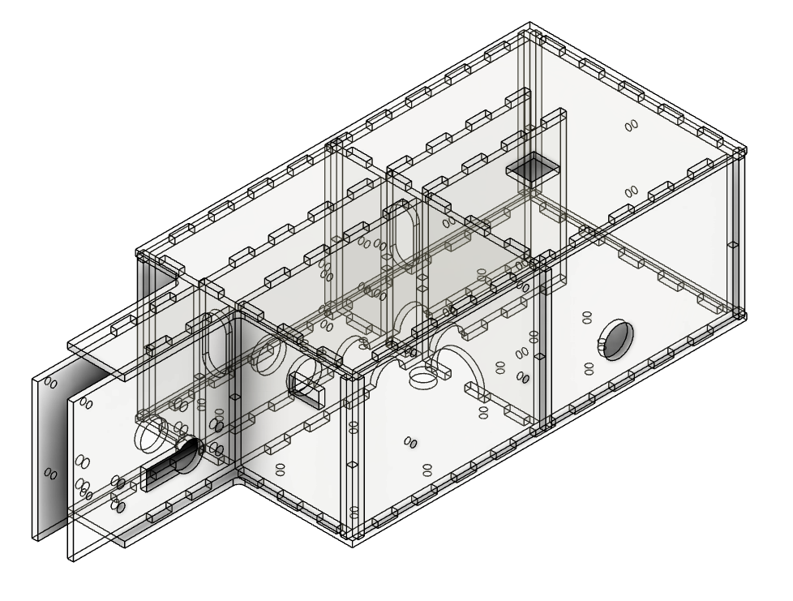
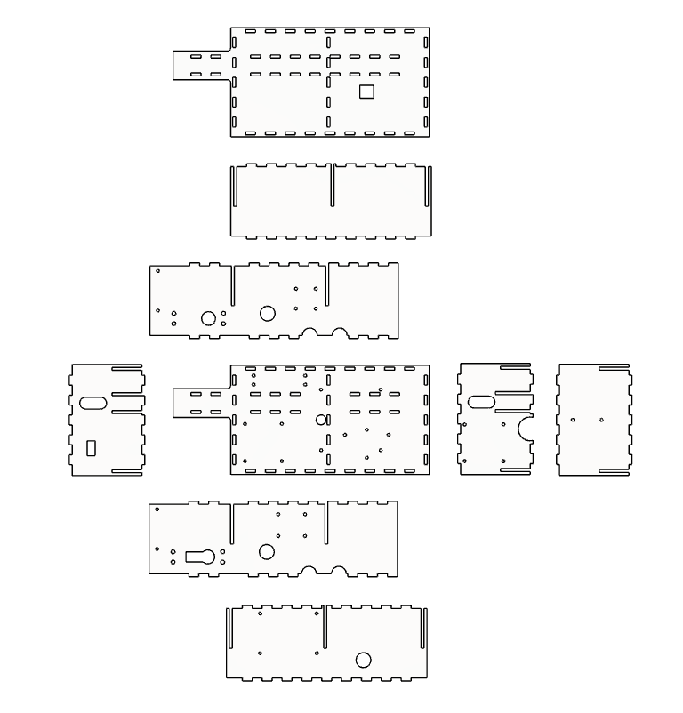
Acrylic box

Slide 52
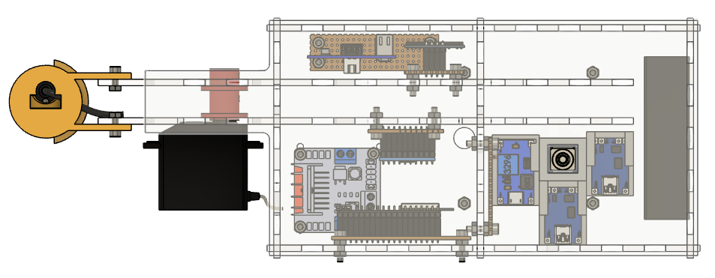
Acrylic box Layout
Mechanism ^
Part Component^
Power Component^

Slide 53
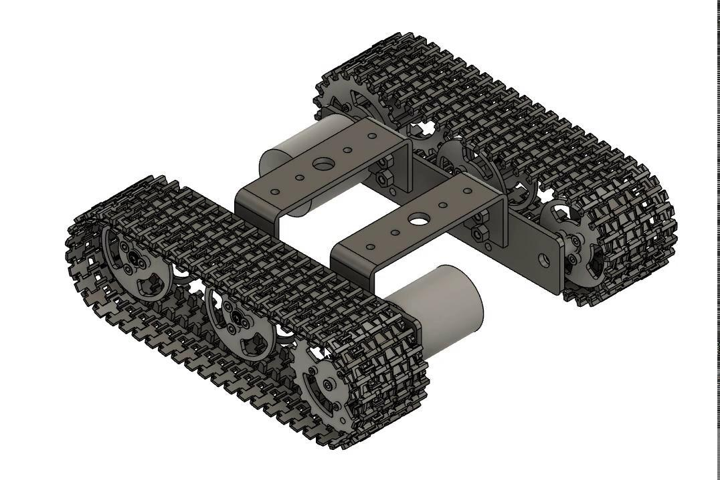
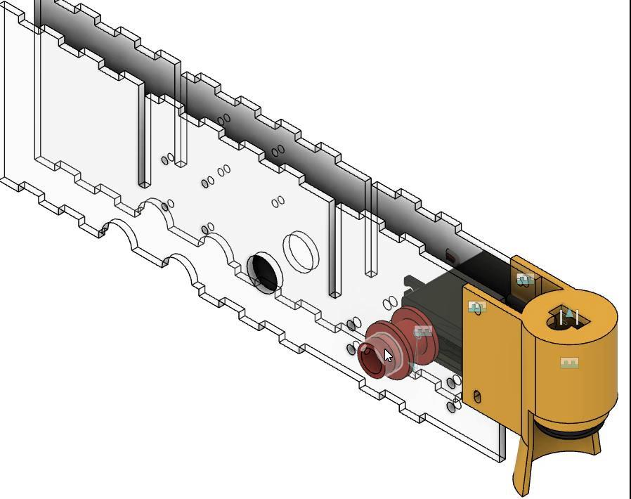
Moving parts in fusion

Slide 54
Torque calculations - Considerations
Slow vehicle
Human walking speed = 1.0m/s - 1.5m/s
Wheel torque desired, Tw< 0.03 Nm

Slide 55
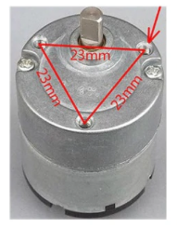
Torque Calculations - motor specifications
Voltage | 12V
Current (In motion) | 700mA
Power | 8.4W
Speed | 350 rpm
Torque | 0.229 Nm

Slide 56
Torque calculations - parameters
Csf(ice) = 0.02
Max RPM (N) = 170 rpm
Angle of incline = 0°
Radius of sprocket (r) = 0.027m
Acceleration time to max speed (tacc) = 60s
RF = 1.1

Slide 57
Torque Calculations
Weight (W) | 17.66 N
Rolling Resistance (RR) | W * Csf= 0.35 N
Grade Resistance (GR) | 0 N
Max Velocity (Vmax) | [(2*pi*N)/60]*r = 0.48 m/s
Force required for acceleration (Fa) | (W * Vmax)/(9.81*tacc) = 0.014 N
Total Tractive Effort (TTE) | RR+GR+Fa = 0.37 N
Wheel Torque (Tw) | TTE * r * RF = 0.011 Nm

Slide 58
Torque calculation - reality check
Tw | 0.011 Nm
µs | 0.05
Ww | W/no. of sprockets = 8.83 N
MTT | Ww * µs * W = 0.012 Nm
Motor Torque | 0.23 Nm
MTT > Tw
Motor torque > Tw

Slide 59
Reflection

Slide 60
Reflection: Allen
Design for manufacturing and assembly
Tolerance
Prototyping
Mechanical and power calculations

Slide 61
Reflection: sean
Always do your work early
Communication is important
Be careful handling circuits
Learnt about the ESP32
Documentation

Slide 62
Reflection: wen da
Micropython
Troubleshooting
Being careful about spelling and capitalization
ESP32
Connect to wifi/use as server
Theory VS Practical
Works in theory but fails when in action
Check cables
Git
Learned how to update using Git
Importance of keeping writing journal
Reflashing ESP32, able to refer

Slide 63
REFLECTION: Jayvien
Always keep a backup of videos/pictures to google drive
Must check the oled library if switching the esp32
Should always put comments while coding

Slide 64

QR CODE FOR OUR BLOG
SCAN ME :D

Slide 65
Thank you

